Slide 1
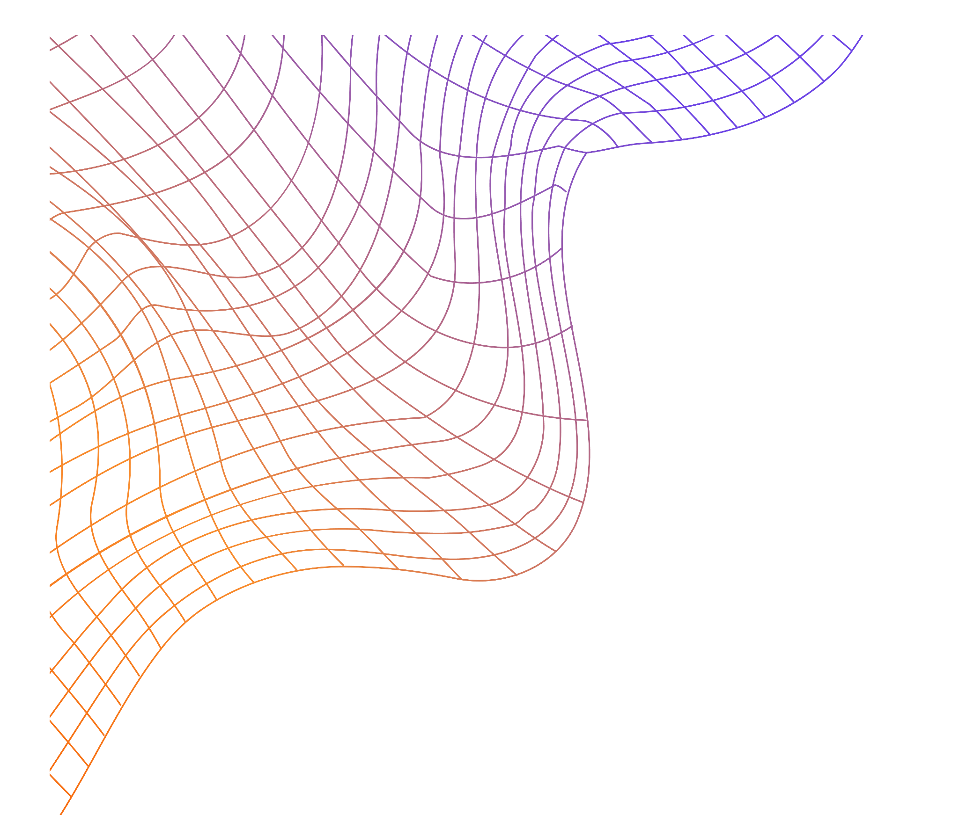
Applications of Fourier Series
SEM 3
Fourier Series in Action: From Waves to Pixels

Slide 2


Made by
Shiven Vasan
Suryansh Vikram Singh Kushwaha
A2305223359
A2305223344

Slide 3
Table of contents
01.
02.
03.
04.
05.
06.
Introduction
Applications
Image Processing
What is Fourier Series?
Where is Fourier series used ?
How is Fourier Series used in image processing ?
Crystallography
Visualization
Conclusion
How is Fourier Series used in crystallography?
Interactive simulator to see how Fourier series work
Summing up everything…

Slide 4
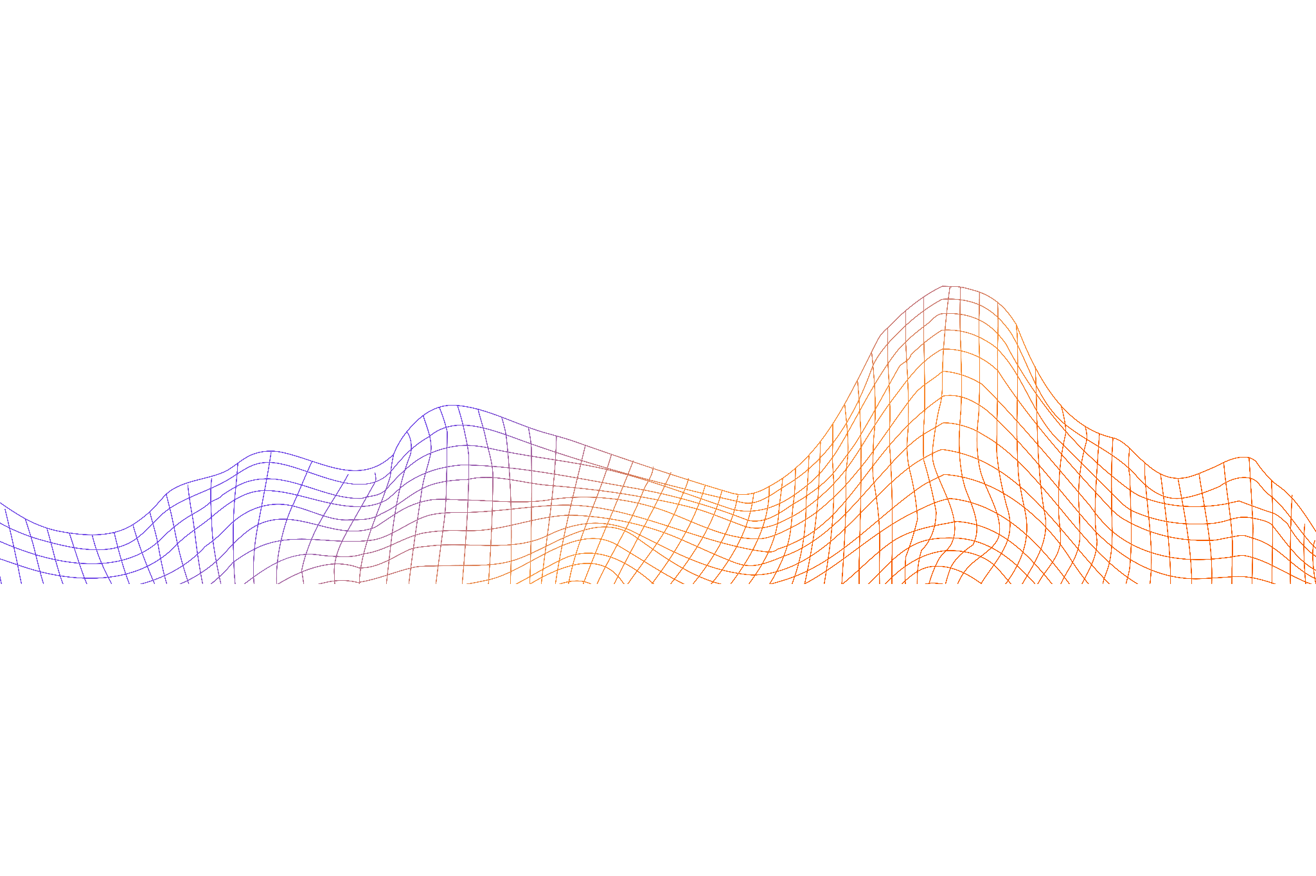
01.
Introduction
Demystifying Fourier series

Slide 5

01. Introduction
Imagine breaking down any complex wave—like music, an image, or even heat—into a simple combination of sine and cosine waves. That’s the magic of Fourier series! Invented by Joseph Fourier, this method helps us represent any periodic function using a sum of basic waveforms.
It’s like discovering the DNA of a wave, where every function is made up of these building blocks. By transforming signals into their frequency components, we can better understand and manipulate them, making Fourier series essential for everything from physics to engineering.

Slide 6
Definition
A Fourier series is a way to represent a function as the sum of simple sine waves.
A simple trigonometric function consists of a smooth surface. If you continue to add these trigonometric functions, you can get a function with a different shape.

Slide 7
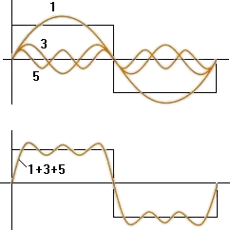
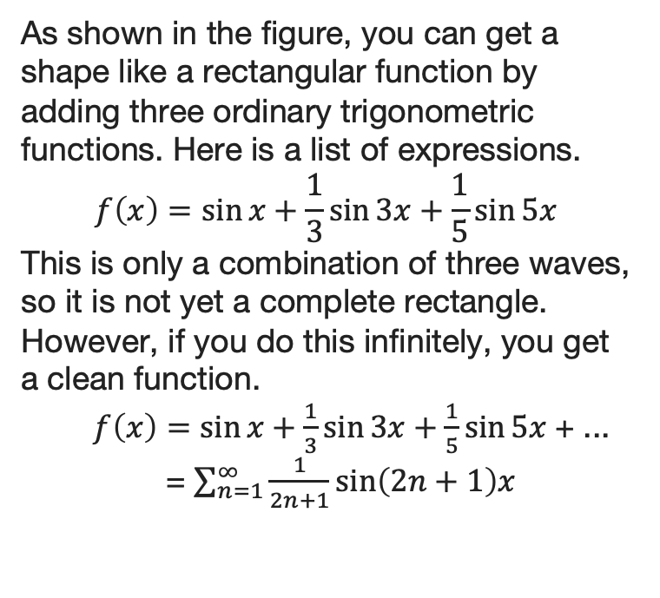
Example
let’s create a square function using a Fourier series.
As shown in the figure, you can get a shape like a rectangular function by adding three ordinary trigonometric functions. Here is a list of expressions.
$$f\left(x\right)=\sin{x+\frac{1}{3}\sin{3x+\frac{1}{5}\sin{5x}}}$$
This is only a combination of three waves, so it is not yet a complete rectangle. However, if you do this infinitely, you get a clean function.
$f\left(x\right)=\sin{x}+\frac{1}{3}\sin{3x}+\frac{1}{5}\sin{5x}$+ ...
= $\sum_{n=1}^{∞}{\frac{1}{2n+1}\sin\left(2n+1\right)x}$

Slide 8
02.
Applications
Where is Fourier series used?

Slide 9
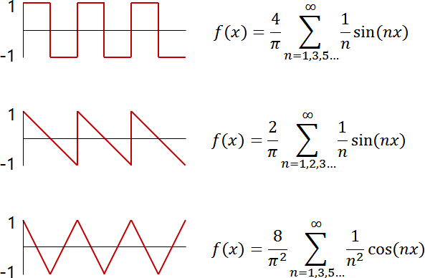
02. Application of Fourier series
Fourier series is often used to obtain a specific waveform in an electronic circuit. For example, the Fourier series for squares and saw-teeth is:

Slide 10
Other Applications
Where else can you find Fourier series in action? Almost everywhere!
In signal processing, they help clean up noise in audio or radio waves.
In heat transfer, they explain how heat spreads over time.
Electrical engineers use them to study alternating current (AC) circuits, while acoustics experts use them to model sound waves.
Even in quantum mechanics, Fourier series make complex calculations manageable.
Wherever periodic patterns appear, Fourier series step in to simplify
and solve!

Slide 11
03.
Image Processing
How is Fourier series used in image processing ?

Slide 12
03. Fourier Series in Image Processing
Image Processing is a crucial task in Computer Vision. For example, when we train a Deep Learning model with a small amount of image data, we need to synthesize new images using Image Processing methods to improve the performance.
Enhances high-frequency components to detect edges and sharpen image lines.
Used in image compression (JPEG) to reduce file size while maintaining image clarity.
Transforms images into the frequency domain for easier manipulation and optimization.

Slide 13
What we are doing with the 2D Fourier Transform is treating the image as a function of pixel position x and y. Imagine the function f(x, y) along axis (0,y):
So, when the colour jumps from "black (0)" to "white (255)", we say the colour changes quickly, which means that a high amplitude and frequency sine wave contribute to that jump.
Therefore, the low-frequency sine waves are responsible for the image's overall colour, while high-frequency waves are responsible for how colour changes.

Slide 14
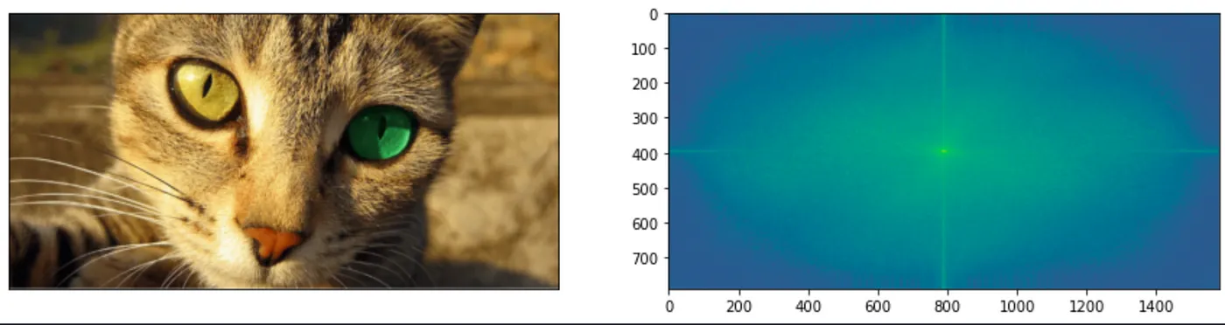
Now we have the formulas, let's see what it looks like this when applied to an image:
The image on the right side is a spectrum of Fourier Transform. It is the heat map where the color represents the sine waves' amplitude, and position is their frequency. But at this point, we may get confused, like, "Hey," what does this tell me about the image?"

Slide 15
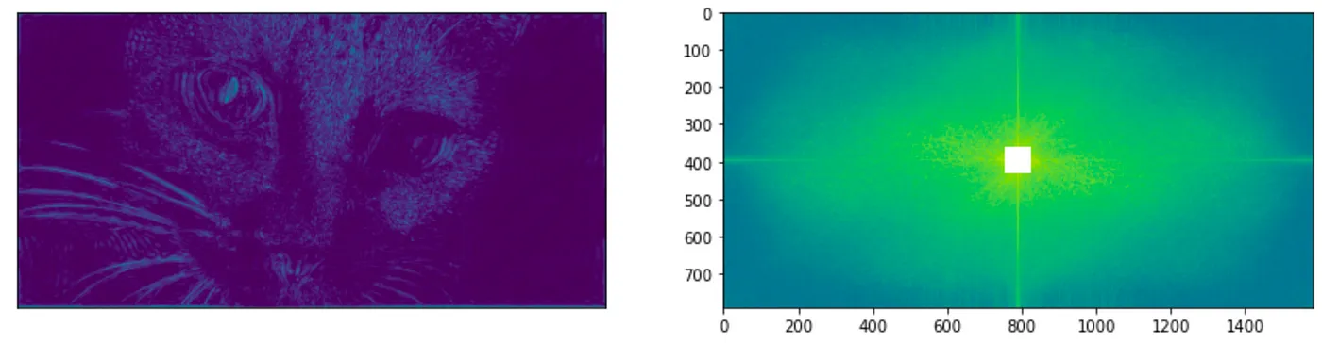
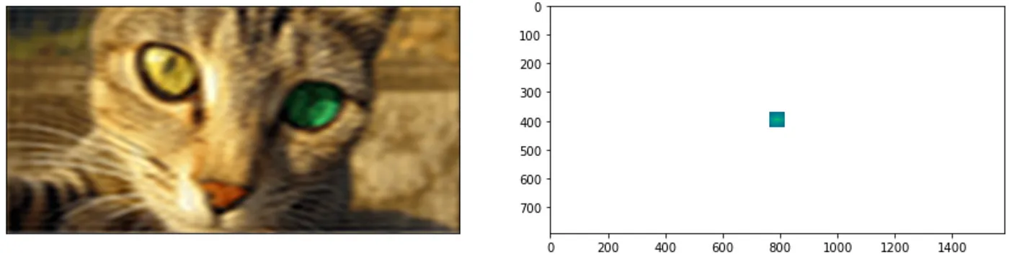
So, when we remove the low-frequency terms, we get an edge detection of the cat. On the opposite side, if we only keep the low-frequency waves, we will get a blurred image. This is so cool when we all need to delete some terms, and we can do ‘blurring’ and ‘edge detection.’

Slide 16
04.
Crystallography
How is Fourier series used in crystallography?

Slide 17
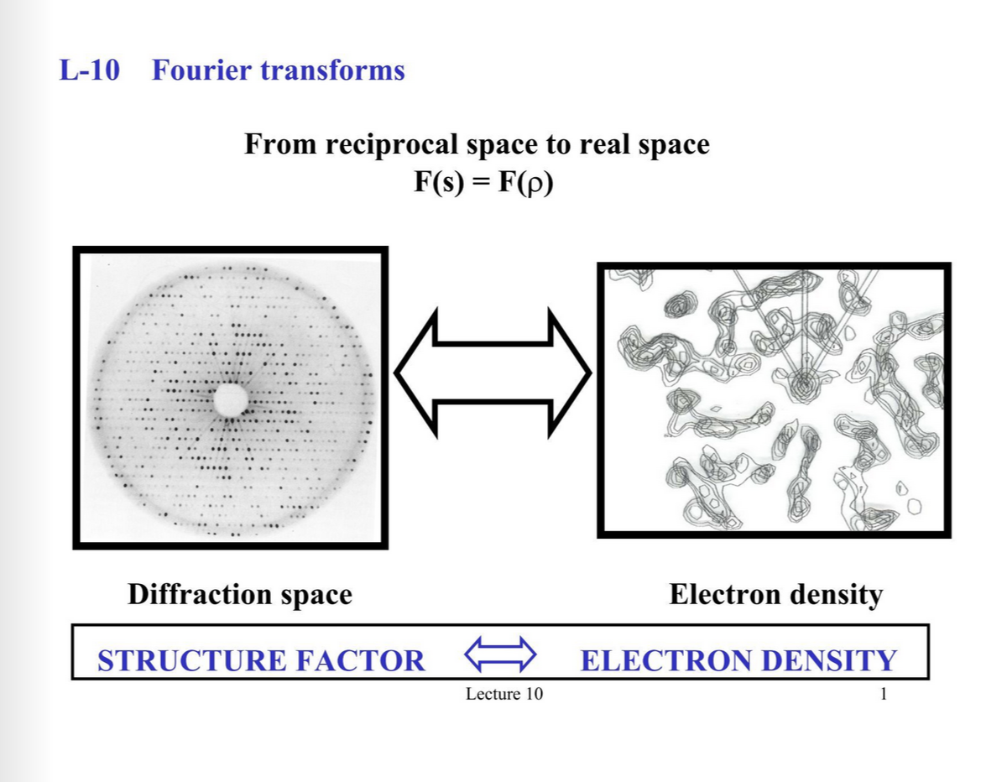
04. Fourier Series in Crystallography
Transforms X-ray diffraction patterns into maps of electron density.
Helps reveal the atomic structure of crystals and materials.
Essential for studying both simple and complex molecular structures.

Slide 18
05.
Visualisation
Interactive simulator to see how Fourier series work

Slide 19
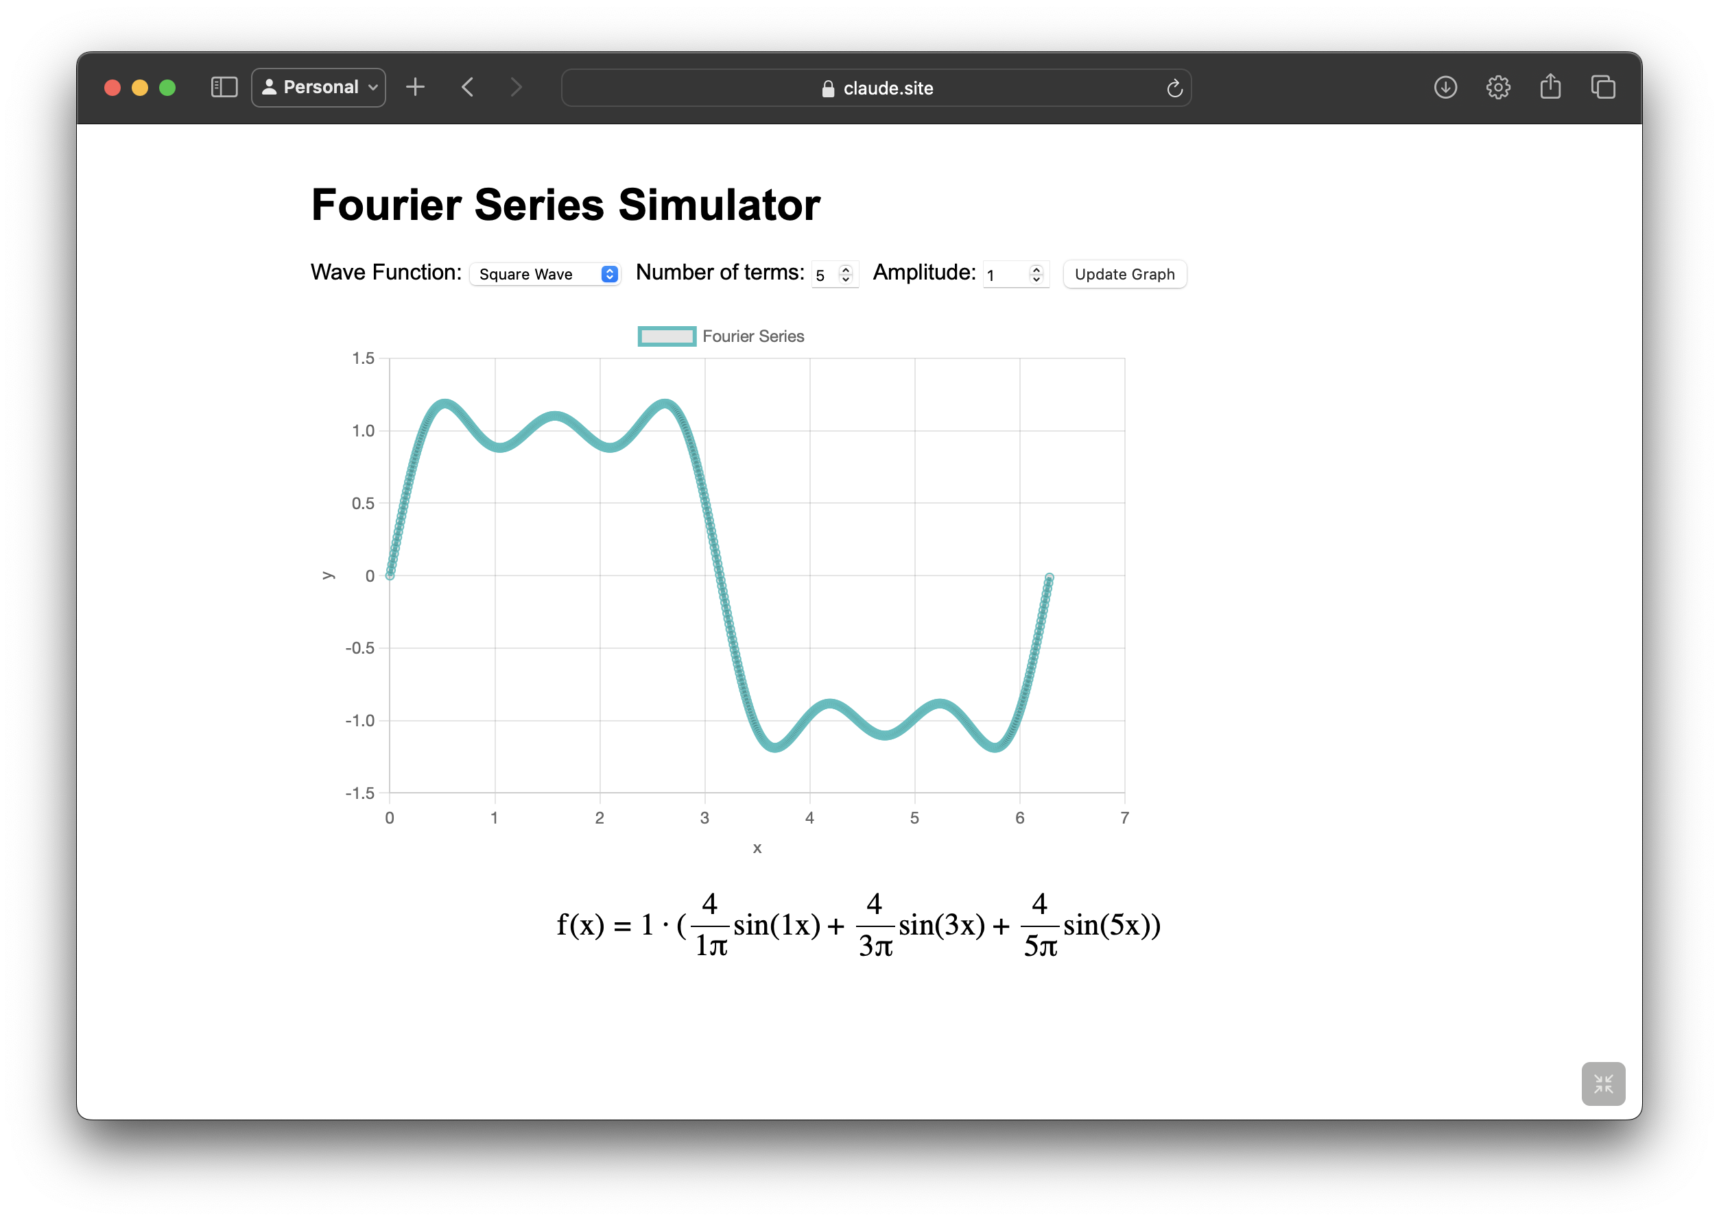
Visualize Fourier Series
We have included an Interactive simulator to see how Fourier series work.

Slide 20
06.
Conclusion
Summing up everything…

Slide 21
06. Conclusion
The Fourier series isn’t just math—it’s a universal tool that transforms how we see the world. Whether you’re analyzing sounds, enhancing images, or mapping out the atomic structure of crystals, the Fourier series helps make the complex understandable. From everyday technologies like image compression to advanced research in physics, its applications are endless. Fourier's insight continues to shape modern science and technology, proving that waves are more than meets the eye!

Slide 22
—Jean-Baptiste Joseph Fourier
“The deep study of nature is the most fruitful source of mathematical discoveries”

Slide 23
Thank you!

